Slide 1
Machine learning and AI
Title: Deep Learning: Transforming Artificial Intelligence
Subtitle: Understanding the Core Concepts and Applications
Presenter's Name: Mahdi Mohammadzadeh, Ali Arabi
Date: 2025/01/28

Slide 2
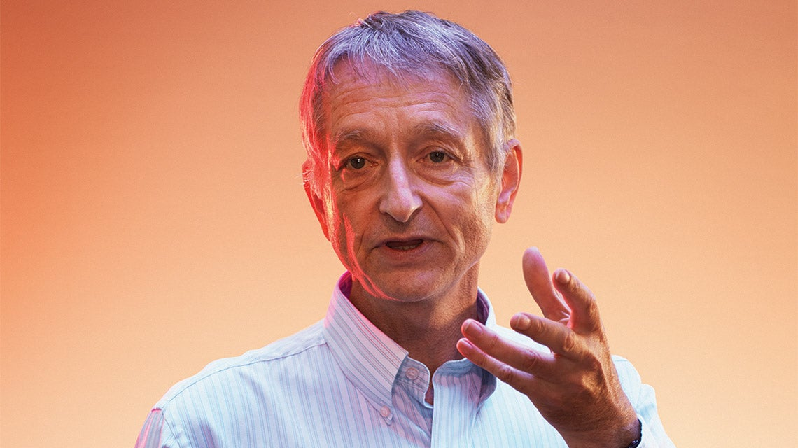
Brief History of Deep Learning
1950s - 1960s: Birth of Neural Networks
Initial concepts of artificial neural networks (ANNs) developed.
Frank Rosenblatt's perceptron model gained attention.
1980s - 1990s: AI Winter and Resurgence
Lack of computational power and data led to the AI winter.
Backpropagation algorithm reintroduced by Hinton, LeCun, and others.
Support Vector Machines (SVMs) dominate machine learning.
2000s - Present: Renaissance of Deep Learning
Availability of big data and GPUs revolutionized deep learning.
Yoshua Bengio, Geoffrey Hinton, and Yann LeCun key figures in deep learning resurgence.
Breakthroughs in image recognition, natural language processing, and more.

Slide 3
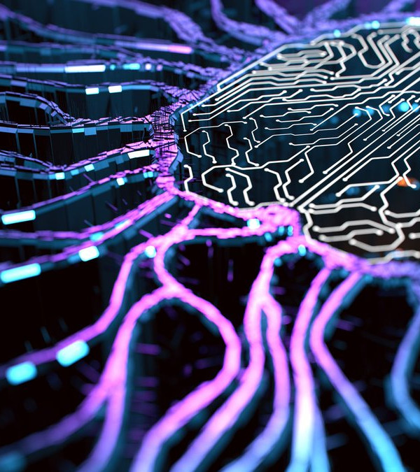
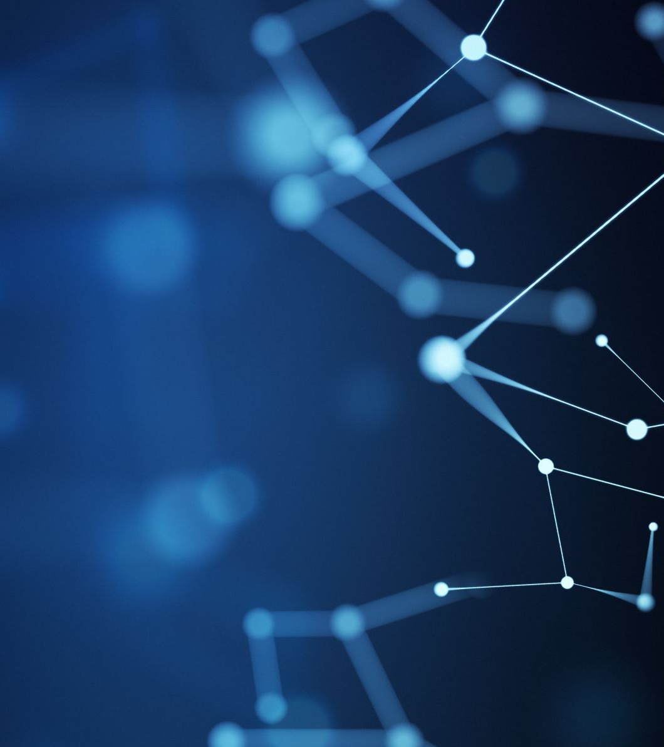
Introduction to Deep Learning
  A type of machine learning involving neural networks with multiple layers that enable the automatic learning of hierarchical feature representations
  Neural Networks: Computing systems inspired by the biological neural networks that constitute animal brains
Importance
  AI Advancement: Deep learning has driven considerable progress in AI, enabling capabilities that were previously unattainable
  Performance: Achieves superior performance in various tasks like image and speech recognition compared to traditional machine learning methods

Slide 4

Analogy
Imagine teaching a child to identify animals. You don’t tell them “Look for whiskers, tails, or specific features”. Instead, you show them lots of examples, and overtime, they figure out on their own what makes a cat different from a dog.
Deep Learning is like this, it learns from examples rather than explicit instructions.

Slide 5
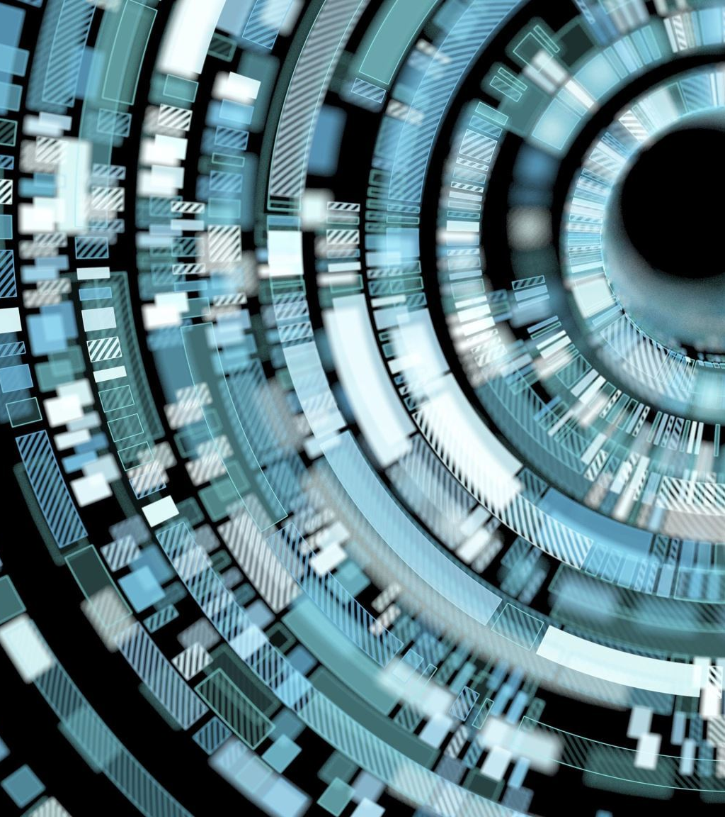
Applications
  Virtual Assistants: Siri, Alexa, and Google Assistant use deep learning for voice recognition and natural language processing
  Recommendation Systems: Platforms like Netflix and Amazon use deep learning to recommend movies, products, and more
  Autonomous Vehicles: Companies like Tesla and Waymo use deep learning for object detection and driving automation

Slide 6
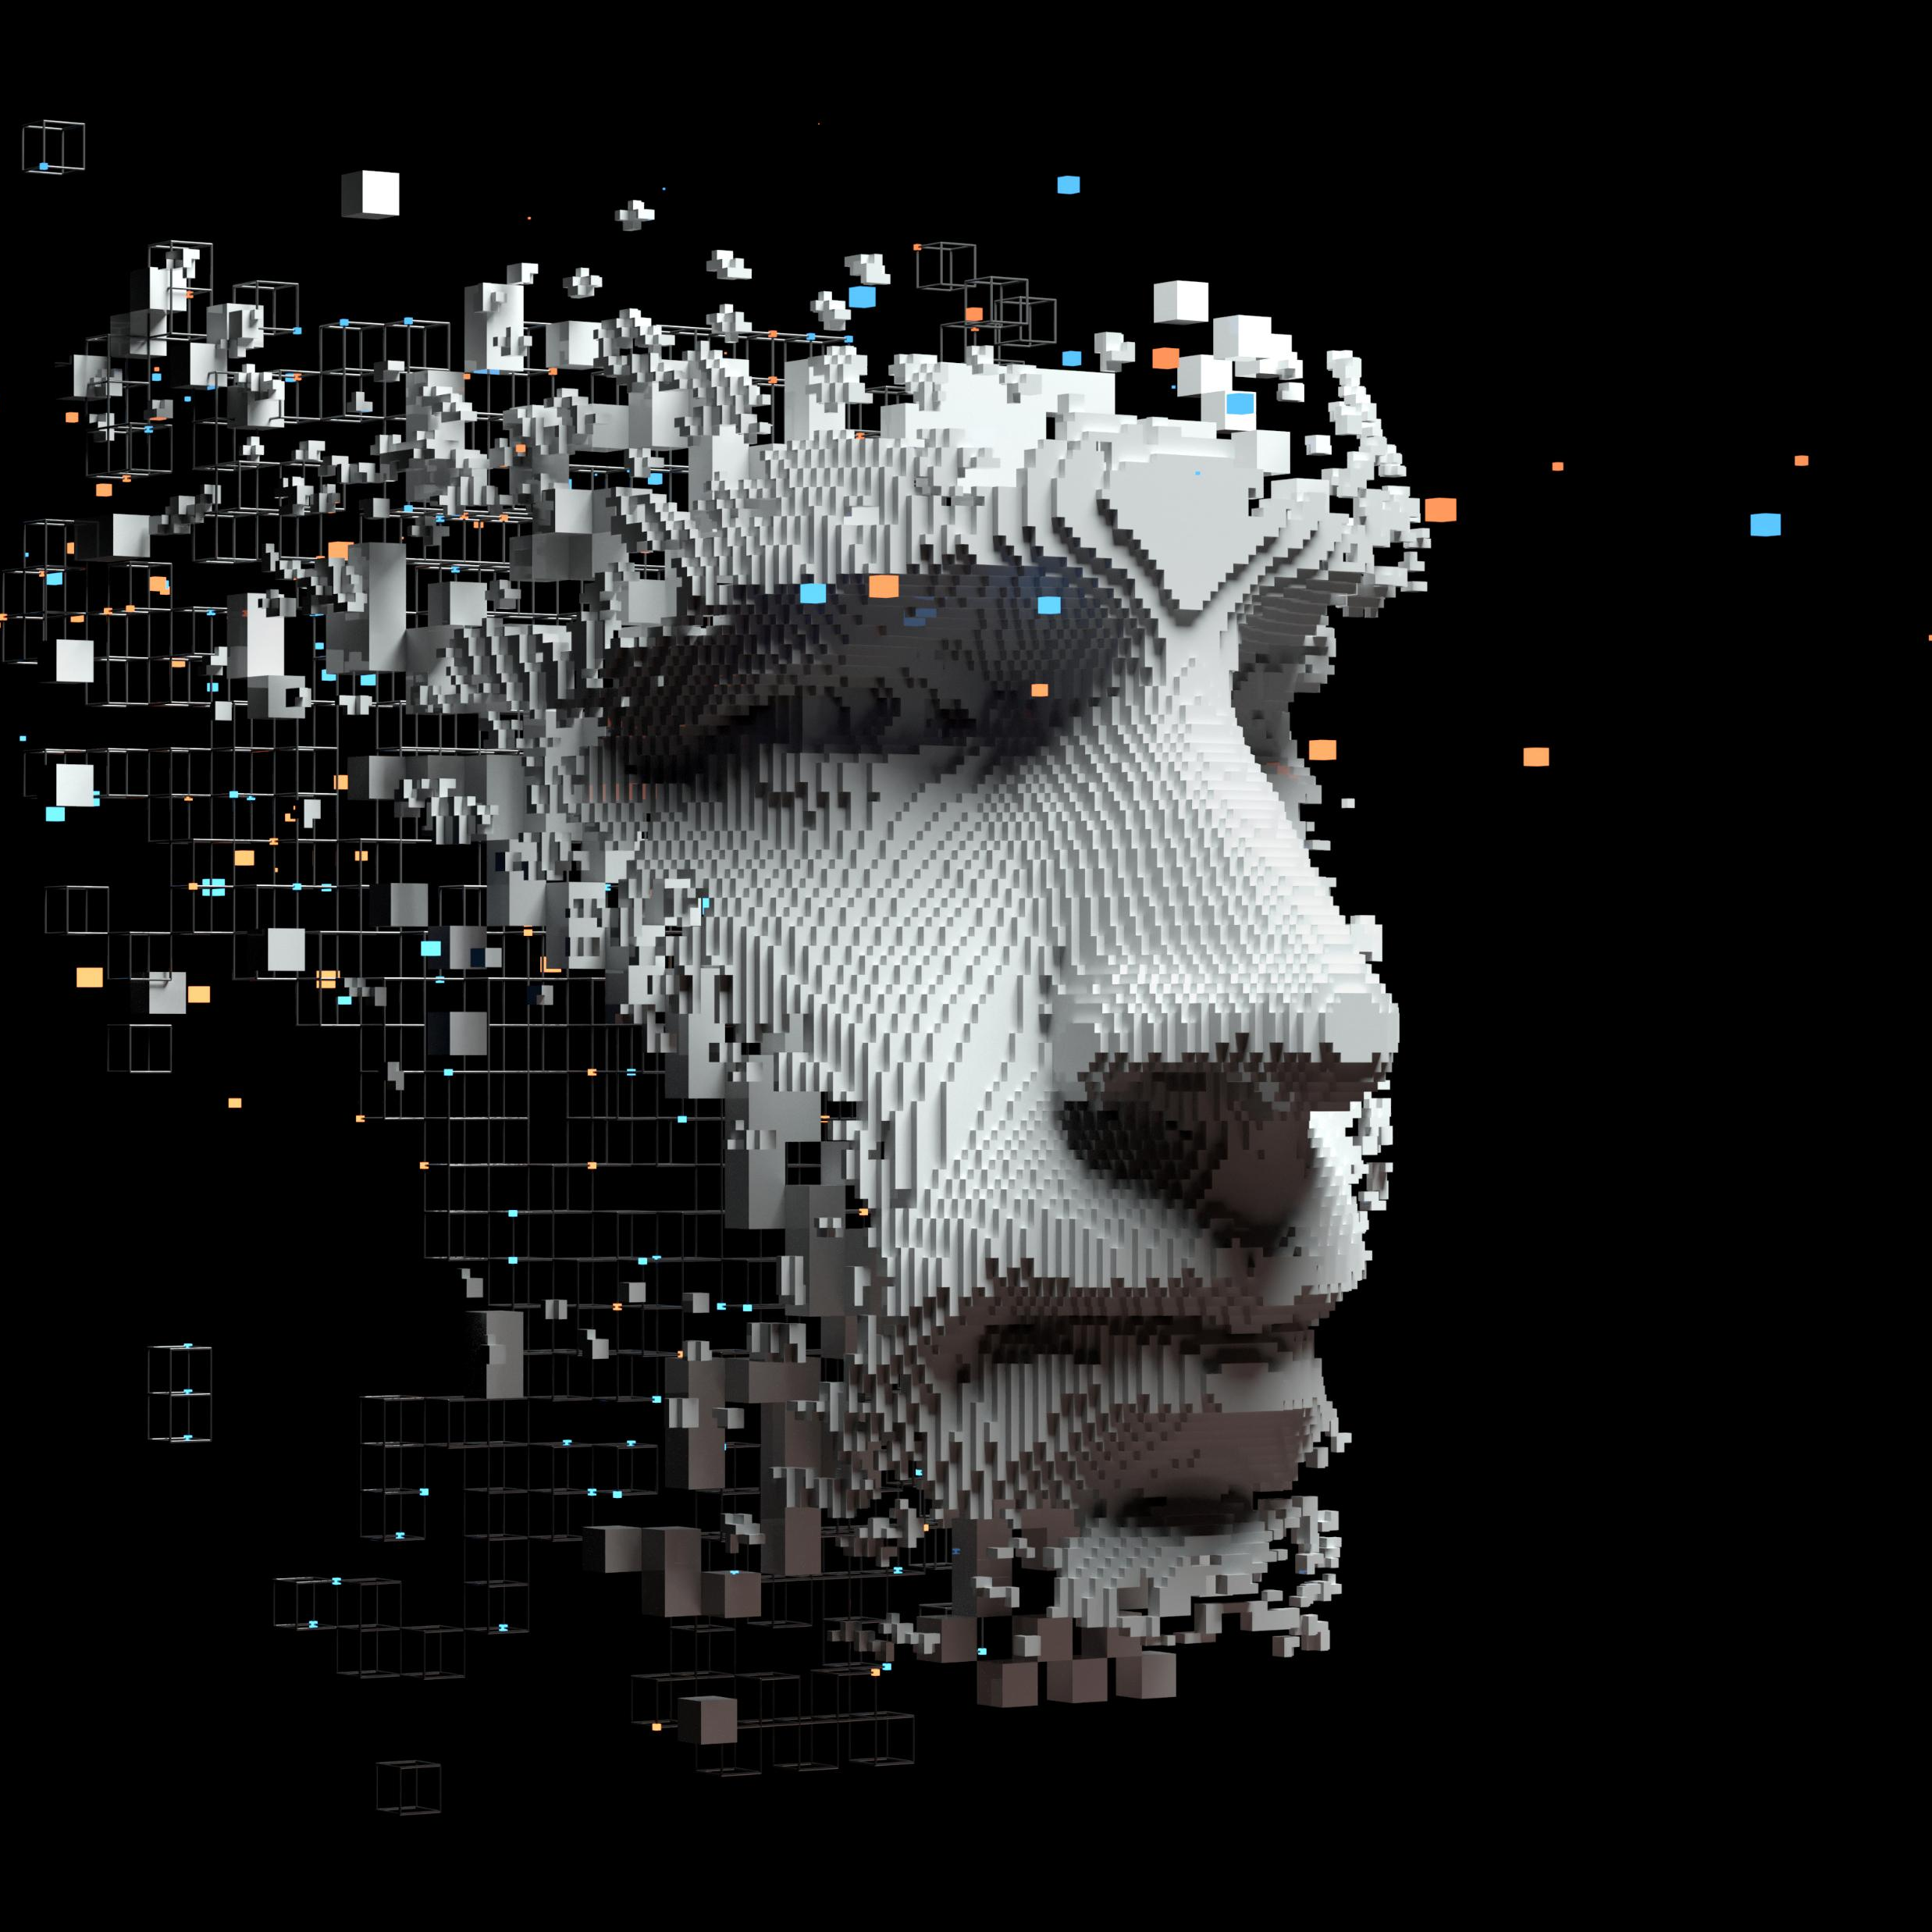
Some methods and challenges of Machine Learning and deep learning

Slide 7

Gradient Descent
Put on a blindfold, take a step downhill. You’ve found the bottom when you have nowhere to go but up!
The goal of gradient descent is to find the minimum of our model's loss function by iteratively getting a better and better approximation of it.

Slide 8
Overfitting
A common problem in machine learning is overfitting.
Overfitting happens when a model overlearns from the training data to the point that starts picking up idiosyncrasies as you make your model increasingly complex
Underfitting is a related issues where your model is not that complex enough to capture the underlying trend in data.

Slide 9
Unsupervised learning
How do you find the underlying structure of a dataset?
How do you summarize it and group it most usefully?
How do you effectively represent data in a compressed format?
These are the goals of unsupervised learning, which is called “unsupervised” because you start with unlabeled data ( there is no Y).

Slide 10
Neural Networks Basics
Structure
Composed of layers of neurons, including input, hidden, and output layers
Each neuron receives inputs, processes them, and passes on the output
Types
Feedforward Neural Networks
Convolutional Neural Networks
Recurrent Neural Networks
Activation Functions
Examples include Sigmoid, Tanh, ReLU

Slide 11
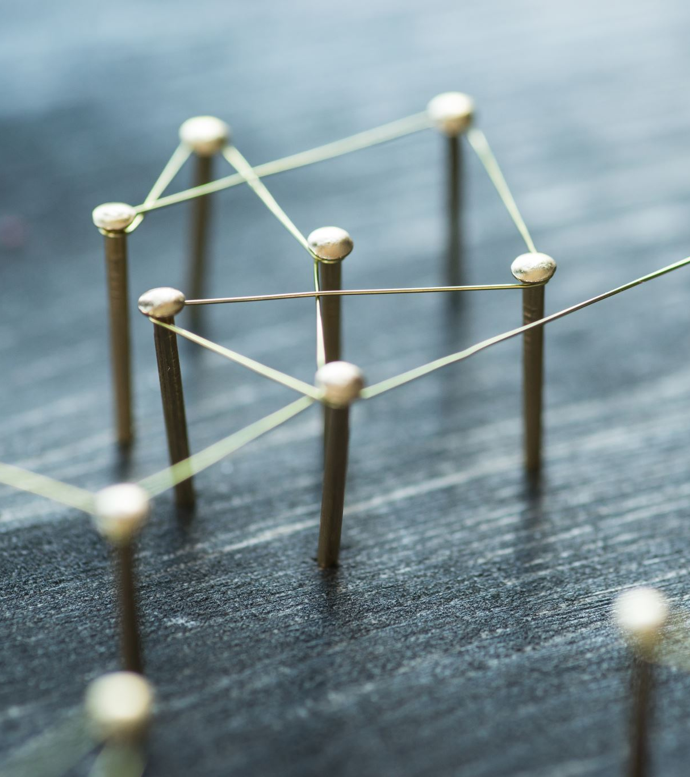
Training Neural networks
Forward Propagation: Data flows from input to output, producing predictions
Loss function: Measures the error between predictions and actual results
Backpropagation: Adjust weights to minimize errors, using the chain rule of calculus

Slide 12
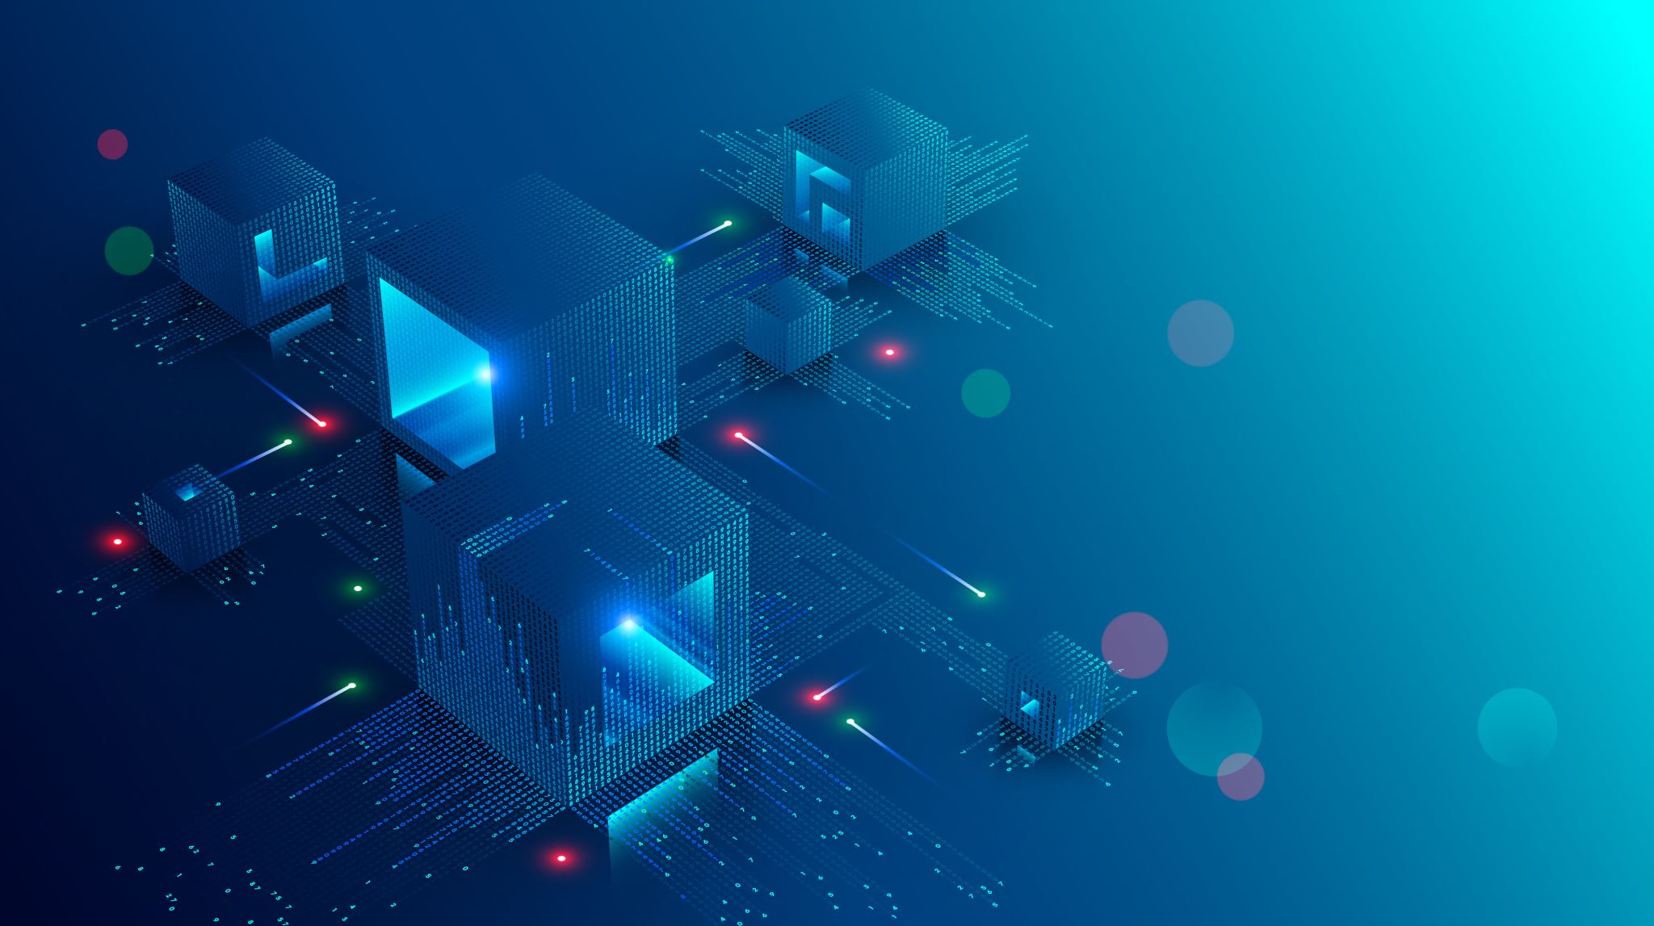
Convolutional Neural Networks
  Convolutional Layers: Applying convolutional operations to extract features from the input data using filters/kernels
  Pooling Layers: Performing down-sampling to reduce the dimensionality and computational load
  Fully Connected Layers: Neurons have full connections to all activations in the previous layer, typically used in the final stages of the network
Applications
  Image Recognition: Used by systems like Google Images and Facebook's auto-tagging feature
  Video Analysis: Applied in surveillance and video content analysis
  Medical Imaging: Helps in detecting anomalies in X-rays, MRIs, and CT scans

Slide 13
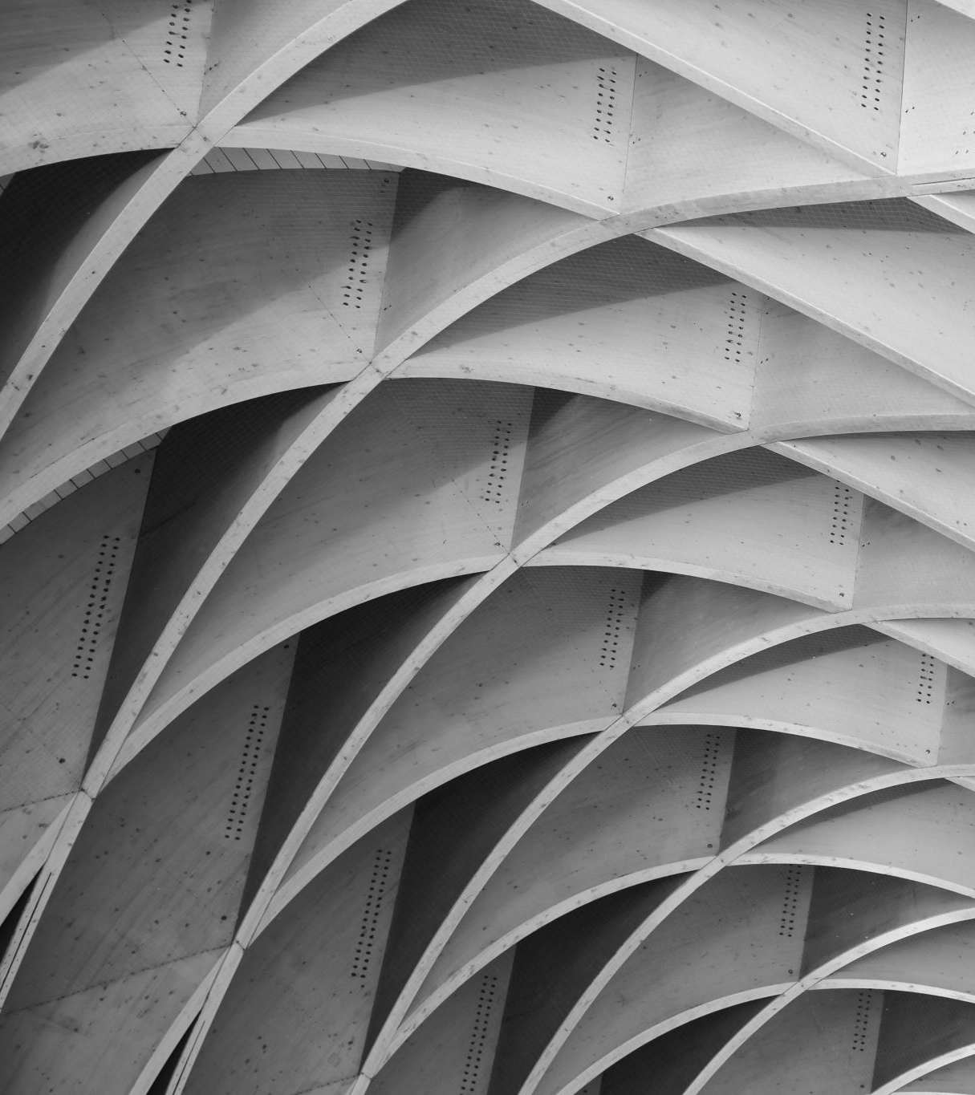
Recurrent Neural Networks(RNNs)
  Designed to recognize patterns in sequences of data, such as time series or natural language
  Contains loops that allow information to be carried across neurons while processing sequential data
Variants
  LSTM : Overcomes the limitations of vanilla RNNs by managing long-term dependencies more effectively
  GRU : Like LSTM but with a simplified architecture, offering a good trade-off between performance and computational efficiency
Applications
  Language Modeling: Used in predictive text, speech recognition, and translation services
  Stock Market Prediction: Analyzing historical data to forecast future trends
  Speech Recognition: Converts spoken language into text in applications like transcription services

Slide 14
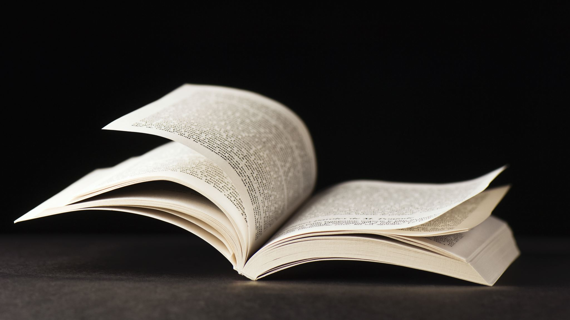
Analogy
Think of a story book:
RNNs remember the plot up to the current chapter but may forget earlier details.
LSTMs act like bookmarks, helping recall crucial events from earlier chapters.
LSTMs can store information for longer periods, making them effective for complex sequences.

Slide 15
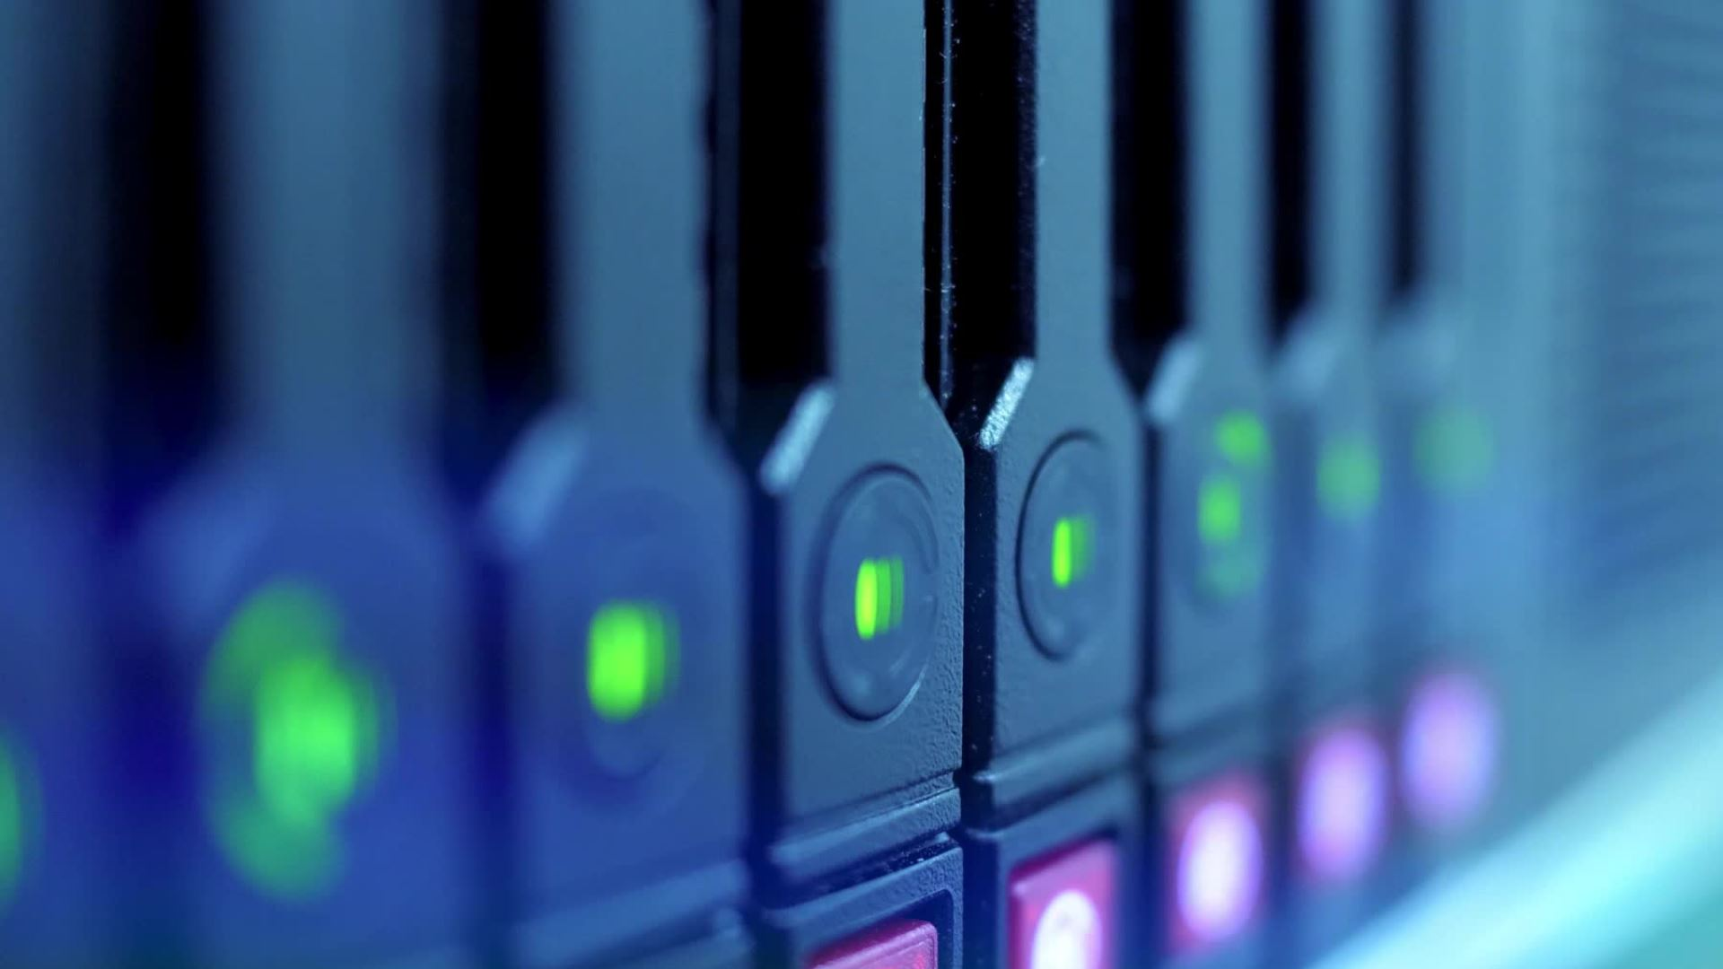
Training Deep Neural Networks
Backpropagation
  Error Calculation: Computes the difference between the predicted and actual outcomes
  Weight Adjustment: Uses gradient descent to update the weights in the network to minimize error
Challenges
  Large Datasets: Deep networks require vast amounts of data to train effectively
  Computational Power: Training deep networks is computationally intensive, often necessitating GPUs or TPUs
  Overfitting: When a model performs well on training data but poorly on unseen data, indicating it has learned noise rather than the underlying pattern

Slide 16
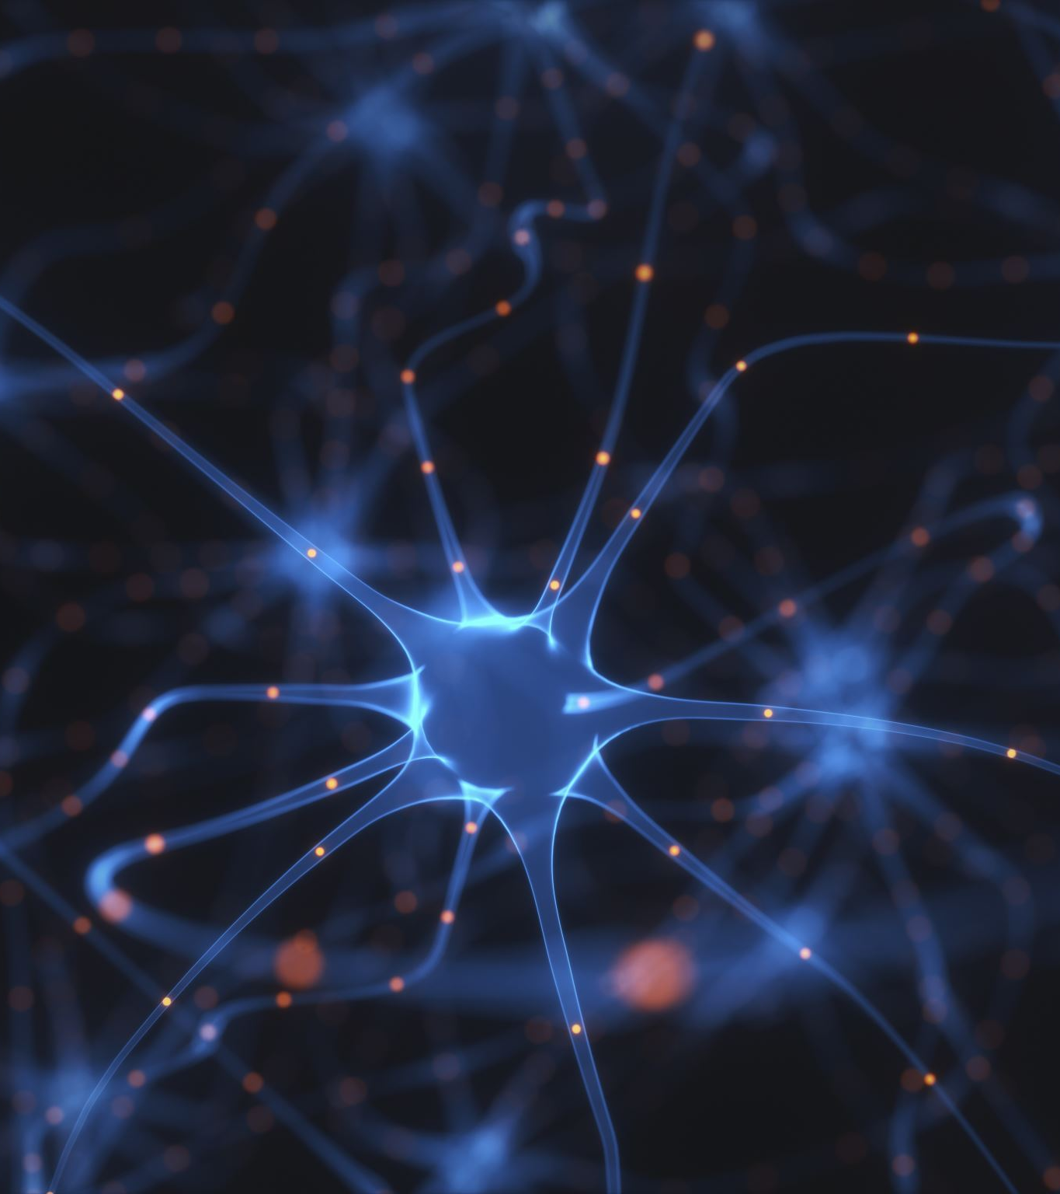
Training Deep Neural Networks
Solutions
  Dropout: Randomly omitting neurons during training to prevent overfitting
  Regularization: Adding a penalty to the loss function to constrain the model's complexity
  Data Augmentation: Generating new training samples by modifying existing data, such as flipping or rotating images

Slide 17
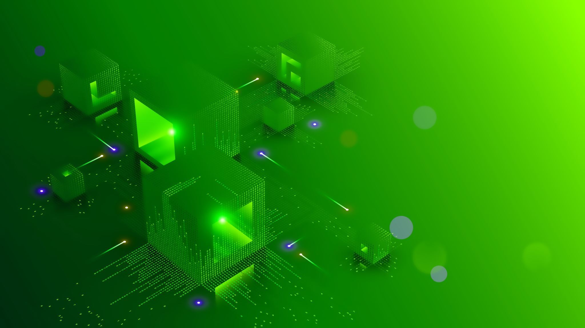
Hardware and Software for Deep Learning
  GPUs : Parallel processing capabilities make them ideal for handling the massive computations in deep learning
  TPUs : Google-designed hardware optimized for TensorFlow, providing accelerated performance for deep learning tasks
  TensorFlow: An open-source framework developed by Google, widely used for building, and deploying machine learning models
  PyTorch: A flexible and easy-to-use framework developed by Facebook's AI Research lab, known for its dynamic computation graph
  Keras: An API that runs on top of TensorFlow, simplifying the process of building and training deep learning models

Slide 18
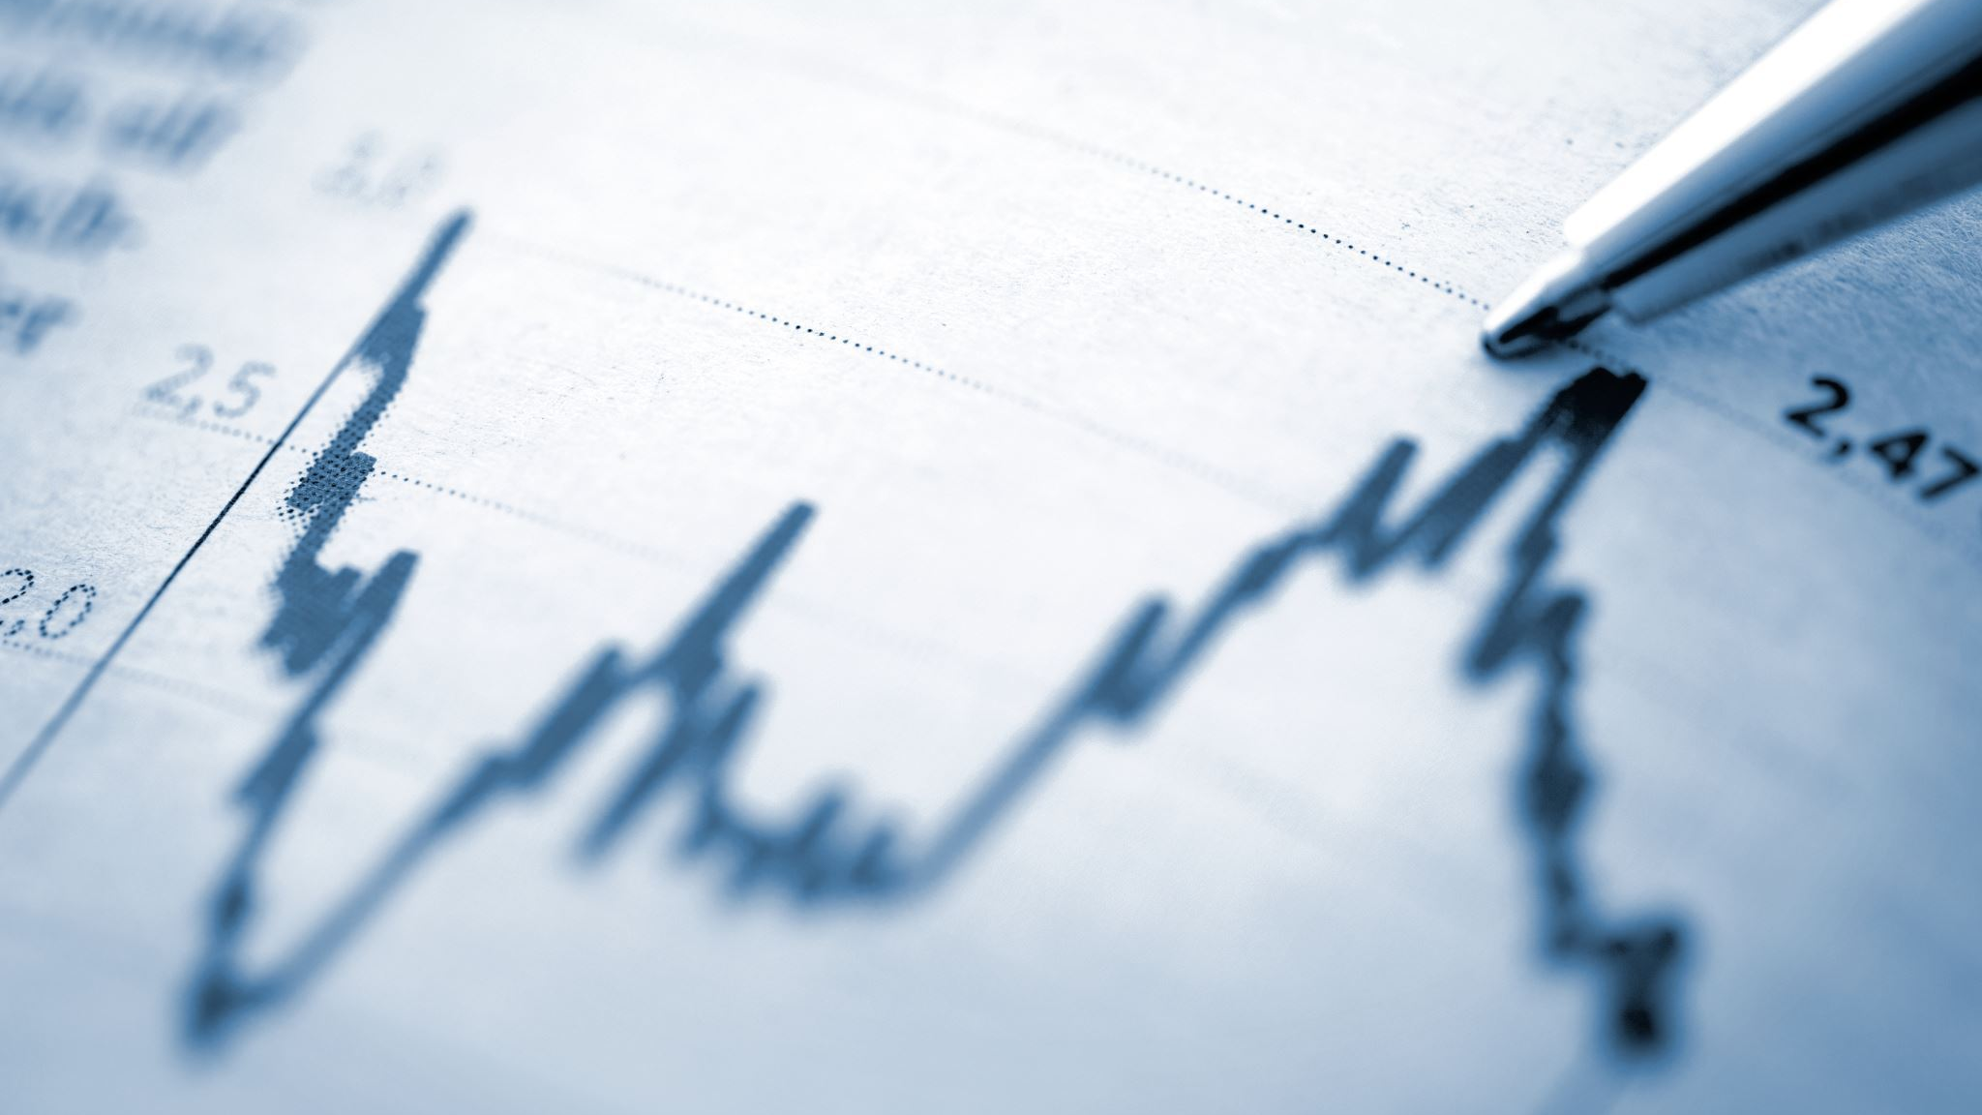
Deep Learning in Practice
  Autonomous Vehicles
    Object Detection: Uses CNNs to identify and classify objects like pedestrians, other vehicles, and road signs
    Navigation: Combines data from sensors and deep learning algorithms to make driving decisions
  Healthcare
    Disease Diagnosis: CNNs analyze medical images to detect conditions such as cancer, often outperforming human radiologists
    Predictive Analytics: RNNs predict patient outcomes based on historical health data
  Natural Language Processing
    Translation: RNNs and transformers enable real-time translation services
    Sentiment Analysis: Analyzes text data to determine sentiment, useful in social media monitoring and customer feedback analysis

Slide 19
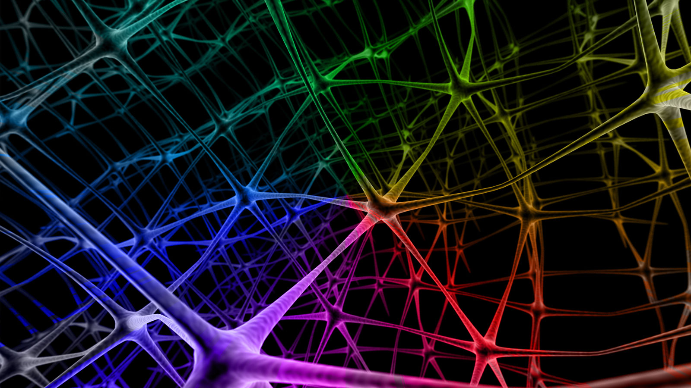
Deep Learning in Practice
Industry Adoption
  Google: Uses deep learning across its services, including search, YouTube recommendations, and Google Photos
  Facebook: Employs deep learning for facial recognition, content recommendation, and advertising
  Microsoft: Integrates deep learning into products like Azure AI, Office, and Cortana
This Photo by Unknown author is licensed under CC BY-NC-ND.

Slide 20

Future Trends in Deep Learning
Continued Advances
  Unsupervised and Semi-Supervised Learning: Reducing reliance on labeled data by improving methods for learning from unlabeled data
  Model Interpretability: Developing techniques to make deep learning models more transparent and understandable

Slide 21

Future Trends in Deep Learning
New Architectures
  Transformers: Leveraging attention mechanisms to improve performance in NLP tasks, replacing RNNs in many applications
  Generative Models: Such as GANs and VAEs , used for generating new data

Slide 22
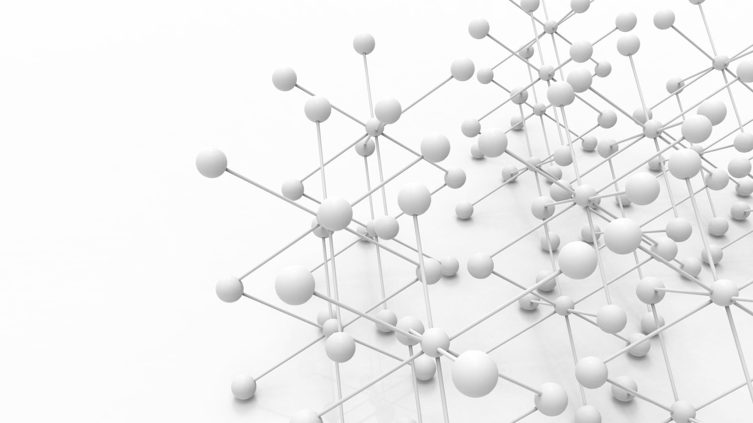
Conclusion and Q&A
    Deep Learning's Significance: Discussed how deep learning is a cornerstone of modern AI, driving advancements in various fields
    Architectures Covered: Explored different neural network architectures, including CNNs and RNNs, and their specific applications
    Training Methods: Highlighted the importance of backpropagation, challenges such as overfitting, and solutions like dropout and regularization
    Practical Applications: Examined real-world examples across industries such as autonomous vehicles, healthcare, and NLP

Slide 23
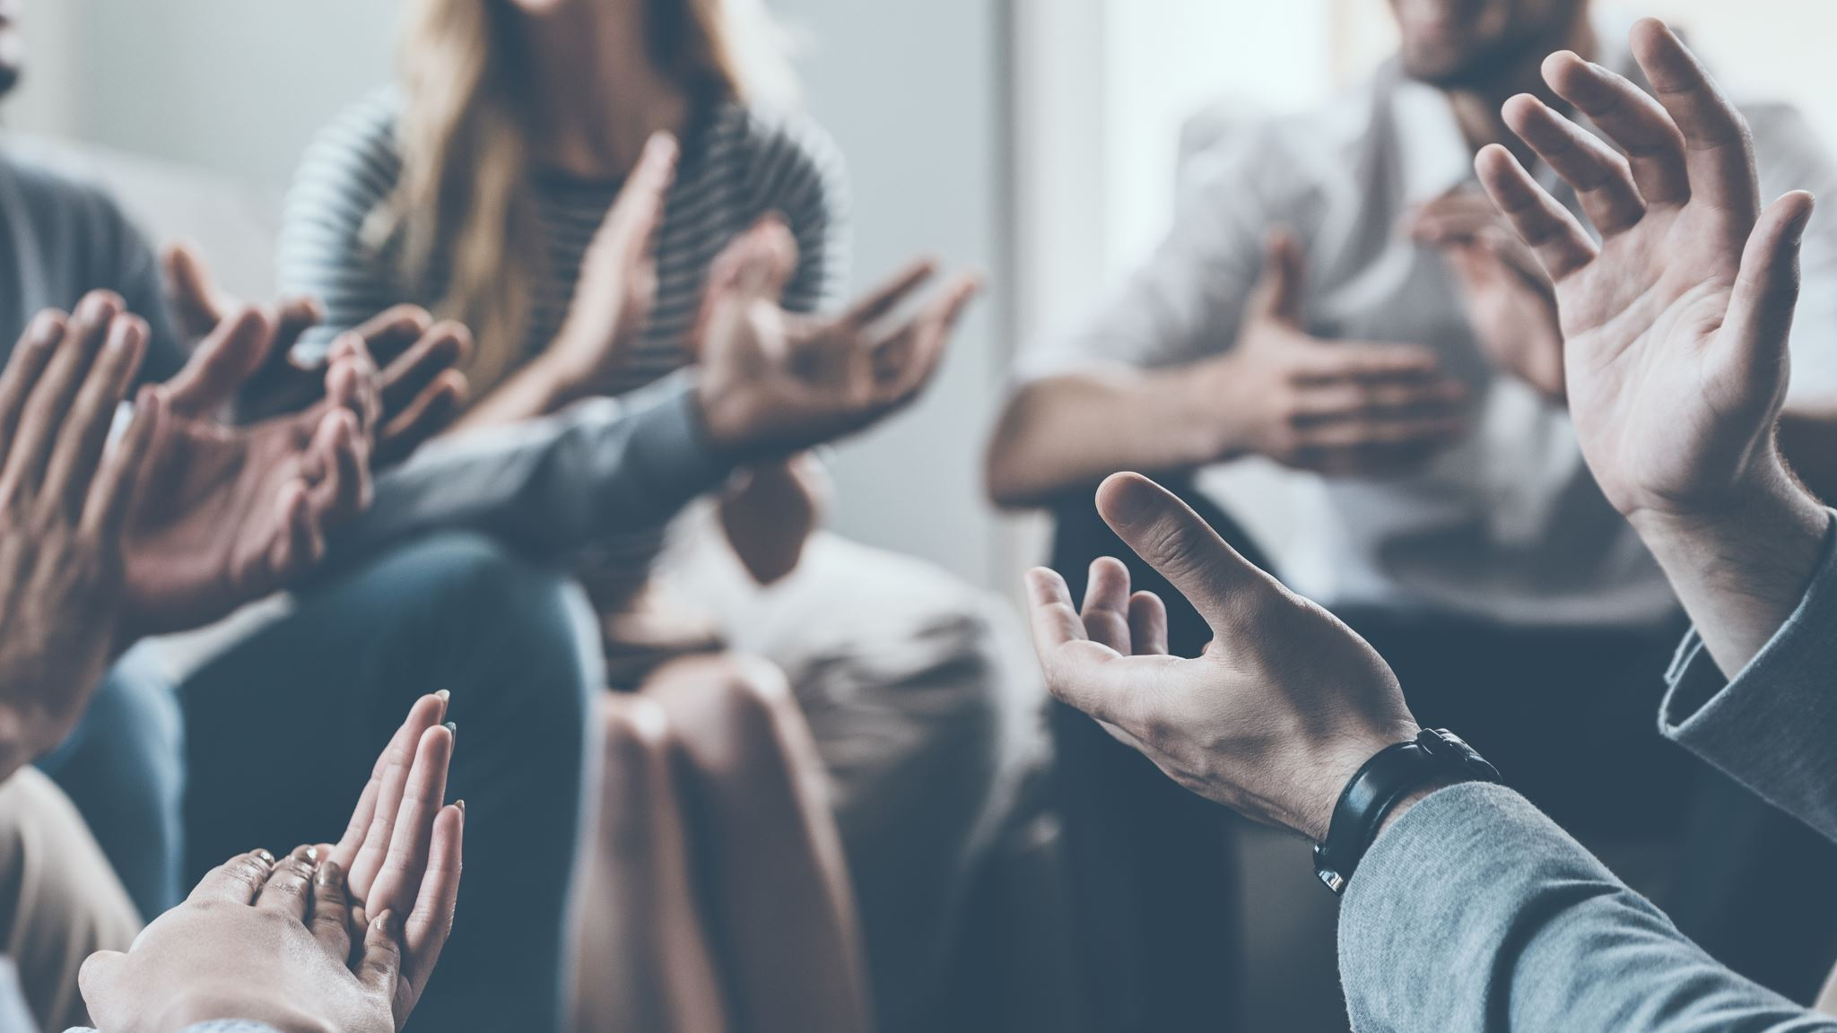
Thank you!
Grazie!

